Slide 1
Lecture # 5-6
Dr. M. Nadeem

Slide 2
Array Operations
Although we can apply conventional operations defined for each element of an array , there are some operations that we can define on an array as a data structure. The common operations on arrays as structures are searching, insertion, deletion, retrieval and traversal.
Although searching, retrieval and traversal of an array is an easy job, insertion and deletion is time consuming. The elements need to be shifted down before insertion and shifted up after deletion.

Slide 3
Array Operations
Operation on array
Traversing (accessing each element at least once)
Insertion
Deletion
Searching
Sorting
Searching and Sorting is fast and efficient in array
Insertion and deletion are difficult and in-efficient in arrays.

Slide 4
Traversing an Array
Algorithm ( Traversing) (Finding Maximum Num from array)
Traverse (A , N, k, max, loc)
START
Set max := A [1], loc := 1, k := 2
WHILE k <= n
IF (max < A[ k ])
max = A[ k ]
loc = k
ENDIF
K = K + 1
ENDWHILE
WRITE: max, loc
END

Slide 5
Insertion
In inserting operation, new items are added into an array. A new item can be added
At the end of array
2. At some specified location within array
3. At Start of array

Slide 6
Insertion at the End of Array
Write an algorithm to add five(5) values into elements at end of array that has already five values stored in first five elements.
1. START
2. Input the elements in the array
3. Repeat for i=6 to 10
Input value n from user
arr[i]=n
End loop
4. END

Slide 7
Insertion at a Specific Location
A new value can be inserted at a specified location in an array.
To insert a new value, the values of all the existing elements are removed one step forward or backward to make space for the new value

Slide 8
Insertion at a Specific Location
Write an algorithm to insert a value M at location pos in an array ar having n elements
1. START
2. Input value in M
3. Input position in Pos
4. WHILE n>=pos
ar[n+1]=ar[n]
n=n-1
ENDWHILE
5. [Insert Value at Position Pos]
ar[pos]=M
6. END

Slide 9
Insertion in array
Algorithm ( Insertion) //insert at any location
Insert ( A, N, k, item)
START
Set j := N, k := 1
WHILE j >= k
A[ j + 1 ] = A [ j ]
j = j – 1
ENDWHILE
4. Set A [ k ] := item
5. Set N := N + 1
6. END

Slide 10
Insertion at a Specific Location
A new value can be inserted at a specified location in an array.
To insert a new value, the values of all the existing elements are removed one step forward or backward to make space for the new value

Slide 11
Deletion
In deletion operation, the elements are removed from the array.
Like Insertion, deletion can be performed
1. At end
2. At specific location
3. At start

Slide 12
Deletion At End
Deleting or removing a data item at the end of array is simple and easy.
To remove the last element from array, the last element is accessed and deleted by placing a null value or by decreasing the size of array by one element of it is the last element of array

Slide 13
Deletion at Some Specific Location
When an item is removed from a specified location within array, the items from the location up to the end of array are moved one location towards the beginning of the array.
The size of array also decreases...

Slide 14
Deletion at Some Specific Location
Write an algorithm to delete the value at location K of an array arr having N elements
1. START
2. Input the values in Array
3. Input Location K
4. If K>n then
Print “ Invalid Location”
Return
End If
5. Repeat for i= k to n-1
arr[i]=arr[i+1]
ENDLOOP
6. END

Slide 15
Deletion in array
Algorithm ( Deletion) //delete from any location
Delete ( A, N, k, item)
START
Set j := k
Set ITEM = A [ k ]
WHILE j <= N - 1
A[ j ] = A [ j + 1]
j = j +1
ENDWHILE
Set N := N – 1 [Reset the number N of elements in LA]
WRITE: item
END
Notes:
LA is linear array

Slide 16
Linear search algorithm
(Linear Search Algorithm) A linear array A with N elements and a specific ITEM of information are given.
This algorithm finds the ITEM and its location LOC in the array A.
A Linear search algorithm solves the problem by comparing ITEM with each elements of Array one by one.
If ITEM is found then its location will be printed otherwise a message “ITEM is not fount” will be printed.

Slide 17
Searching from an Array
Algorithm (Linear Search )
Search ( A, loc, item, N)
START
Set k := 1 and loc := 0
WHILE loc = 0 & k <= N
IF item = A [k] then
set loc := k
ENDIF
set k = k + 1
ENDWHILE
4. IF loc = 0 then
Print: search unsuccessful or item not found
ELSE
Print: search successful or item found at loc
5. END.

Slide 18
Array Examples (Pseudocode)
Searching Maximum from an Array
Step 1: Start.
Step 2: Read: N inputs for DATA Array
Step 3: Set LOC := 1 and MAX := DATA[1]
Step 4: FOR k = 2 to N step 1
If MAX < DATA[k], then
LOC := k and MAX := DATA[k].
EndIf
ENDFOR
Step 5: Print: LOC and MAX
Step 6: Exit

Slide 19
Array Examples (Pseudocode)
Searching Minimum from an Array
Step 1: Start.
Step 2: Read: N inputs for DATA Array
Step 3: Set LOC := 1 and Min := DATA[1]
Step 4: FOR k = 2 to N step 1
If Min> DATA[k], then
LOC := k and Min := DATA[k].
EndIf
ENDFOR
Step 5: Print: LOC and Min
Step 6: Exit

Slide 20
Array Examples (Pseudocode)
Average of Array elements
Step 1: Start.
Step 2: Read: N inputs for DATA Array
Step 3: Set Sum = 0
Step 4: FOR k = 1 to N step 1
Sum := Sum+ DATA[k]
ENDFOR
Step 5: Average=Sum/N
Step 6: Print Average
Step 7: Exit

Slide 21
Array Representation in Memory
One Dimension Array representation
Two Dimension Array representation
Column major
Row major
Multi Dimension Array
Column major
Row major

Slide 22
Matrix
Matric are mathematical terms which refers to collection of numbers which are analogous (linear and 2D arrays)
An m x n matrix A is an array of m – n as numbers arranged in m rows and n columns
Sparse Matrices
Matrices with a relatively high proportion of zero entries are called sparse matrices
Triangular Matrices
All the degree above the diagonals are zero
Tri-diagonal Matrices
one degree above and below the diagonal is non-zero

Slide 23
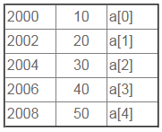
Introduction to Array
Consider Following Example in which an array of five elements is stored sequentially in memory.

Slide 24
Finding Location in Array
In One Dimensional Array location of element A[i] can be calculated using following equation:
LOC (A[i]) = Base_Address + W * (i) Here, Base_Address is the address of first element in the array. W is the word size. It means number of bytes occupied by each element. Suppose we want to calculate the address of element A [2]. It can be calculated as follow: Base_Address = 2000, W=2, i=2
LOC (A [i])=Base_Address + W *i
LOC (A [2]) =2000 + 2 *2
=2004

Slide 25
Row Major Order Representation of Array
Row Major Order is a method of representing multi dimension array in sequential memory.
In this method elements of an array are arranged sequentially row by row.
Thus elements of first row occupies first set of memory locations reserved for the array, elements of second row occupies the next set of memory and so on.

Slide 26
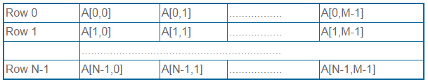
Row Major Order Representation of Array
Consider a Two Dimensional Array consist of N rows and M columns. It can be stored sequentially in memory row by row as shown below:

Slide 27
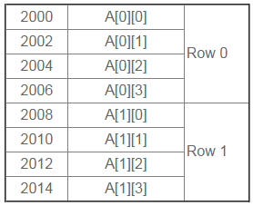
Row Major Order Representation of Array
Example: Consider following example in which a two dimensional array consist of two rows and four columns is stored sequentially in row major order as:

Slide 28
Row Major Order Representation of Array
The Location of element A[i, j] can be obtained by evaluating expression:
LOC (A [i, j]) = Base_Address + W [M (i) + (j)]
Here, Base_Address is the address of first element in the array.
W is the word size. It means number of bytes occupied by each element.
N is number of rows in array.
M is number of columns in array.
Suppose we want to calculate the address of element A [1, 2].

Slide 29
Row Major Order Representation of Array
It can be calculated as follow: Here,
Base_Address = 2000, W= 2, M=4, N=2, i=1, j=2
LOC (A [i, j])=Base_Address + W [M (i) + (j)]
LOC (A[1, 2])=2000 + 2 *[4*(1) + 2]
=2000 + 2 * [4 + 2]
=2000 + 2 * 6
=2000 + 12
=2012

Slide 30
Column Major Order Representation of Array
Column Major Order is a method of representing multi dimension array in sequential memory.
In this method elements of an array are arranged sequentially column by column.
Thus elements of first column occupies first set of memory locations reserved for the array, elements of second column occupies the next set of memory and so on.

Slide 31
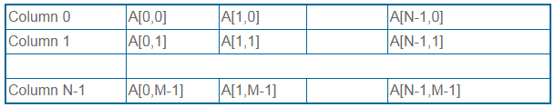
Column Major Order Representation of Array
Consider a Two Dimensional Array consist of N rows and M columns. It can be stored sequentially in memory column by column as shown below:

Slide 32
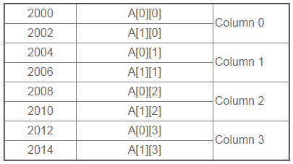
Column Major Order Representation of Array
Example: Consider following example in which a two dimensional array consist of two rows and four columns is stored sequentially in Column Major Order as:

Slide 33
Column Major Order Representation of Array
The Location of element A[i, j] can be obtained by evaluating expression:
LOC (A [i, j]) = Base_Address + W [N (j) + (i)]
Here,
Base_Address is the address of first element in the array.
W is the word size. It means number of bytes occupied by each element.
N is number of rows in array.
M is number of columns in array.
Suppose we want to calculate the address of element A [1, 2].

Slide 34
Column Major Order Representation of Array
It can be calculated as follow: Here,
Base_Address = 2000, W= 2, M=4, N=2, i=1, j=2
LOC (A [i, j])=Base_Address + W [N (j) + (i)]
LOC (A[1, 2])=2000 + 2 *[2*(2) + 1]
=2000 + 2 * [4 + 1]
=2000 + 2 * 5
=2000 + 10
=2010

Slide 35
Arrays: Pros and Cons
Pros:
Fast element access.
Cons:
Impossible to resize.
Many applications require resizing!
Required size not always immediately available.

Slide 36
Disadvantages of Array
Using an Array here has disadvantages.
Most importantly, when an element is added or removed, the elements to the right have to be moved as well.
Linked list can be easily expanded or reduced; Array needs a contiguous memory space and may not even be possible to resize.

